Slide 1
111 Spring
DBMS Final Project
Crowdfunding Platform

Slide 2
Examples of Crowdfunding Platforms
https://www.kickstarter.com/
https://www.zeczec.com/
https://www.flyingv.cc/
https://wabay.tw/

Slide 3
Scenario – Non-Member
George wants to build up a crowdfunding platform. The following description applies all users who have not registered and logged in as members of the platform:
The homepage would list the most popular proposals, and the popularity indicates the number of clicks.
Users can search for proposals with keywords on the platform.
Notes:
在未登入的情況下進到首頁，首頁會列出熱門度最高的提案，熱門度表示被點擊次數
所有人皆能在平台上用關鍵字查詢提案

Slide 4
Scenario – Members
George wants to build up a crowdfunding platform. The following description applies all members who have registered on the platform and are logged in:
The homepage would list the proposals followed by the member and those recommended by the system, both are listed by category.
Members may follow one or multiple proposals.
Members may interact with the proposer by leaving the comment in ​​the proposal comment area.
A member may also be a proposer.
Members may sponsor one or multiple proposals.
Notes:
登入後首頁會顯示該登入者所追蹤的提案以及推薦提案(按照類別)
使用者可以追蹤喜歡的提案項目
使用者能夠在提案的留言區中跟提案者留言互動
會員可以同時是提案者
使用者能夠贊助提案商品
使用者可以於同個提案進行多次贊助
在使用者進行贊助前必須確認該提案是否已經過期

Slide 5
Scenario – Members
George wants to build up a crowdfunding platform. The following description applies all members who have registered on the platform and are logged in:
6. Members are allowed to sponsor a proposal multiple times.
7. Members may only sponsor ongoing/active proposals.
8. After the proposer makes a proposal, it must be reviewed by the platform before being
displayed on the webpage.
9. Proposers may edit the proposal content, FAQ and reply to comments after the proposal is
published.
10. After the proposer creates a proposal, he/she can invite other members to become
co-proposers, who can also edit the content of the proposal, FAQ, and reply to messages.
Notes:
提案者的提案必須經由平台審查，通過者才能顯示於網頁中
提案者可編輯提案內容、常見問題與回覆留言
一個提案可以由多個提案者組成提案團隊，共同編輯提案內容、常見問題與回覆留言

Slide 6
Scenario – Members
George wants to build up a crowdfunding platform. The following description applies all members who have registered on the platform and are logged in:
11. Each proposal has 90 days period for fundraising, after which the system would forcibly
stop the proposal, but if 90% of the target amount has been raised at the end of the 90 day
period, the proposal is automatically extended for another 30 days. The extension is applied
only once.
12. There are only three proposals status: (1)UNDER-REVIEWING (2)ONGOING and
(3)EXPIRED; the status can only be updated in the order of 1 → 2 → 3.
13. Members may follow proposers.
Notes:
每項提案都有固定募資時段，超過該時段系統會強制停止募資，但若已經募達目標金額的百分之九十，則能夠再延長三十天一次
每項提案的狀態只有三種：審查中、募資中、已到期，狀態更新過程只能遵循「審查中 → 募資中 → 已到期」順序

Slide 7
Entities
Member(proposer)
MemberCredential
Proposal
ProposalOption (Product under a given proposal)
Comment
FAQ
SponsorRecord (record of which proposal option the member sponsored)
FollowingRecord
ProposalMember
Category

Slide 8
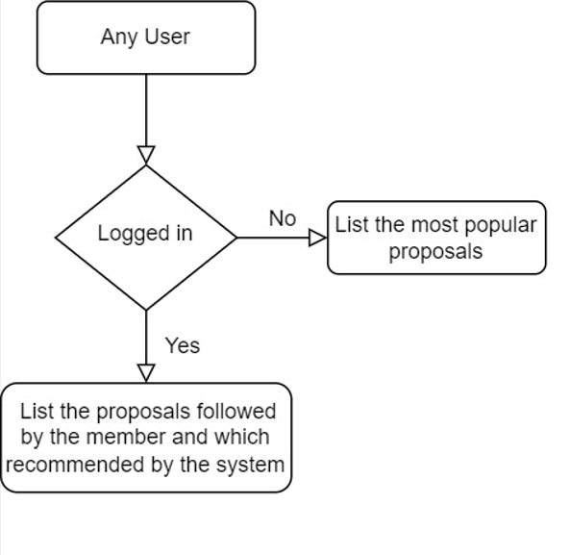
Flow Chart - Home Page

Slide 9
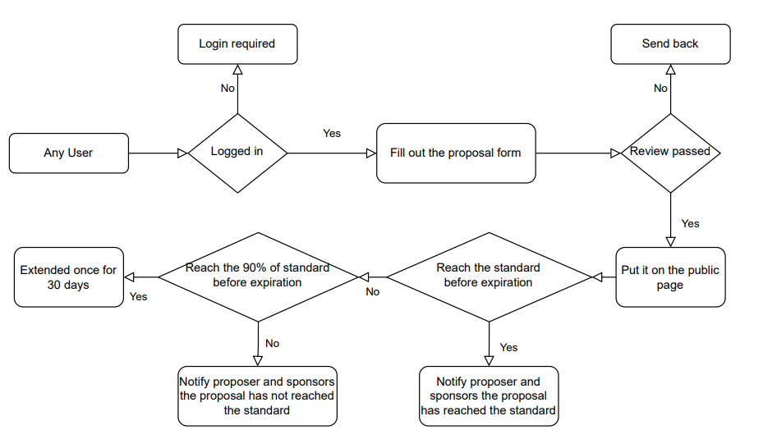
Flow Chart - Proposal Process

Slide 10
Business logics
A user can only have one account.
A member may also be a proposer.
Members must be logged in to propose, comment, and sponsor.
Members can comment on multiple proposals and proposers can reply.
Each comment would only have one corresponding reply.
Proposals that have not yet expired are eligible for member sponsor.
A member may sponsor multiple proposals.
A member may have multiple proposals.
A proposal would have one or more products (proposal options), each product would only appear in one proposal.
Notes:
一個使用者只能擁有一個帳號
使用者也能同時是提案者
使用者必須登錄才可提案、留言、進行贊助
使用者能夠在多個提案中進行留言，提案者能夠進行回覆
每則留言只會有一則相對應的回覆
尚未過期的提案才能夠接受使用者的贊助
一個使用者可以贊助多個提案
一個使用者可以擁有多個提案
一個提案會有一到多個商品(贊助選項)，每項商品只會出現在一項提案中

Slide 11
Business logics
A proposal may associateted with multiple proposers.
A member may follow multiple proposals, and each proposal could be followed by multiple members.
Proposer could update proposals, reply to comments, add/modify/delete FAQs.
Proposal has only one unique proposal ID.
After expiration, proposals that have accumulated more than 30 days would be deactivated by the platform.
Notes:
一項提案可以擁有多個提案者
一個使用者可以追蹤多項提案，每項提案可以被多個使用者追蹤
提案者可以更新提案、回覆留言、新增/修改/刪除常見問題
提案只有一個提案ID
過期之後，累積時間超過三十天的提案將被平台刪除(停用)

